Slide 1







PREDICTION OF SALARY HIKE BASED ON EXPERIENCE
Application of Machine Learning
Get Started

Slide 2

01.
02.
03.
Objectives
Solution
Business Impact
content.
Table of

Slide 3


Objectives
salary prediction
ML model development
estimating equation of regression line

Slide 4
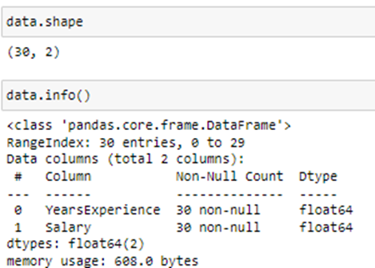
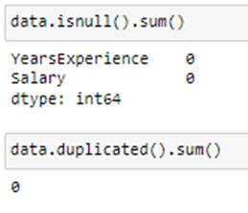
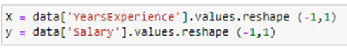
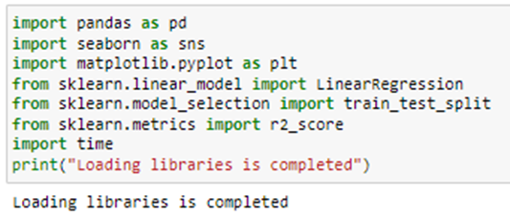
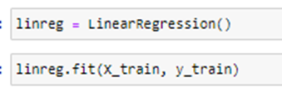
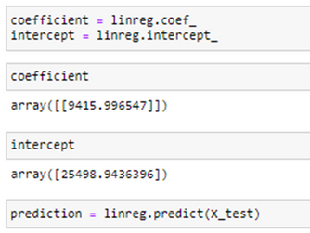
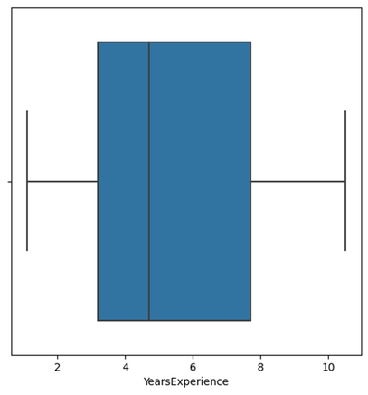
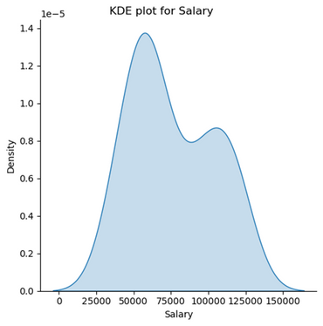
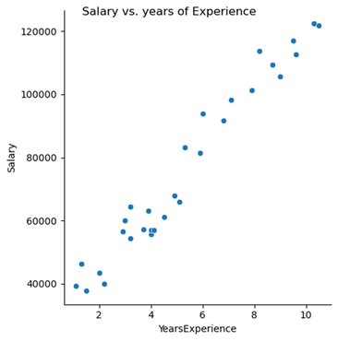
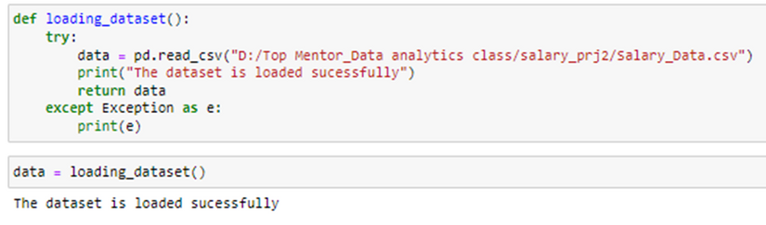
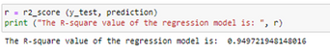
Solution
Libraries importing
Data Loading
Data Exploration
Data Preprocessing
EDA
Model development

Slide 5



Prediction of Salary
Employees can estimate their salary based on the experience they have.
Business Impact
Selection of company
Employees can identify whether an organisation has provided his/her the right salary or not.
estimation of salary
HR Manager can estimate appropriate salary for the employees.

Slide 6

Thank
You.

